Slide 1
NETWORK AUTOMATION & GNS3
GNS3 REST API AND PARAMIKO

Slide 2
Objective
This project uses GNS3 REST API to make a topology in GNS3 environment. It uses GET,POST methods to create topology. Network Automation was used to configure routers, switches using python scripts which is using Paramiko implementation to connect to devices and configure them. I think it’s a great ease for network engineers if they want to replicate the same configuration to multiple devices. They just need to get-set-go their device and they can easily run it.
If, you still wondering, what GNS3 is ?
GNS3 allows you to visualize, plan, test and troubleshoot network environments across any vendor platform at scale - without the need to directly interact with the network hardware. With the intuitive graphical interface, users can seamlessly connect all types of virtual interfaces to compose a real representation of networks. GNS3 runs on traditional PC hardware and may be used on multiple operating systems, including Windows, Linux, and Mac OS X.

Slide 3
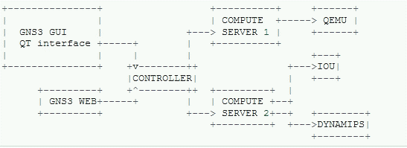
GNS3 ARCHITECTURE
GNS3 is divided in four parts:
GUI - Displays the topology.
Controller - Pilots everything, manages the state of a project.
Compute - Emulators are executed here.
Emulators - For each node of the topology will start an emulator instance.
If you want to pilot GNS3, you need to use the controller API.

Slide 4
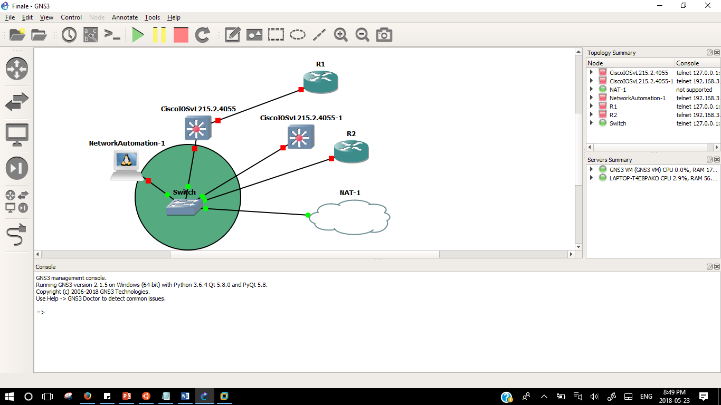
GNS3 GUI

Slide 5
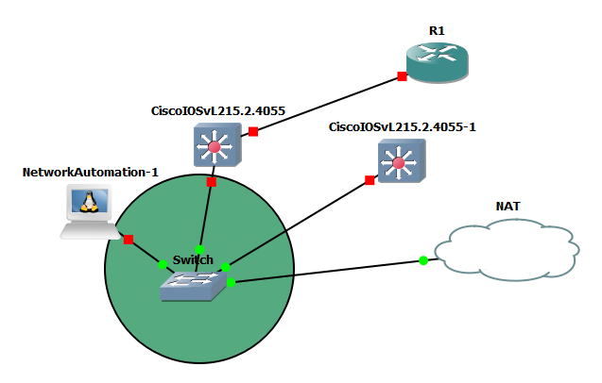
How GNS3 REST API built topology ?
Create project-"POST"
Get project id
“GET”
Create node-"POST"
Get node id
“GET”
Link node id
“POST”

Slide 6
Network automation
Network Automation is a powerful container in GNS3 which provides all the popular tools used for network automation such as Netmiko, Paramiko,etc.
Paramiko is a Python (2.7, 3.4+) implementation of the SSHv2 protocol, providing both client and server functionality. Paramiko itself is a pure Python interface around SSH networking concept.

Slide 7
Thank you !!
Karan anand
B00766408

